Slide 2
Rapidly Develop Mobile Solutions on the Oracle Cloud
Anirban Bagchi
North America Mobile Specialist Team

Slide 3
Notes:
This is a Safe Harbor Front slide, one of two Safe Harbor Statement slides included in this template.
One of the Safe Harbor slides must be used if your presentation covers material affected by Oracle’s Revenue Recognition Policy
To learn more about this policy, e-mail: Revrec-americasiebc_us@oracle.com

Slide 4
The World Has Gone Mobile
We look at our phones more than we look at our loved ones
150 the average number of times a person look as their mobile each day
Notes:
http:/mazharlaliwala.wordpress.com/2013/04/15/mobile-learning-smartphone-and-mobile-app-usage-an-infographic-approche/
medical - http://mobihealthnews.com/7505/72-percent-of-us-physicians-use-smartphones/

Slide 5
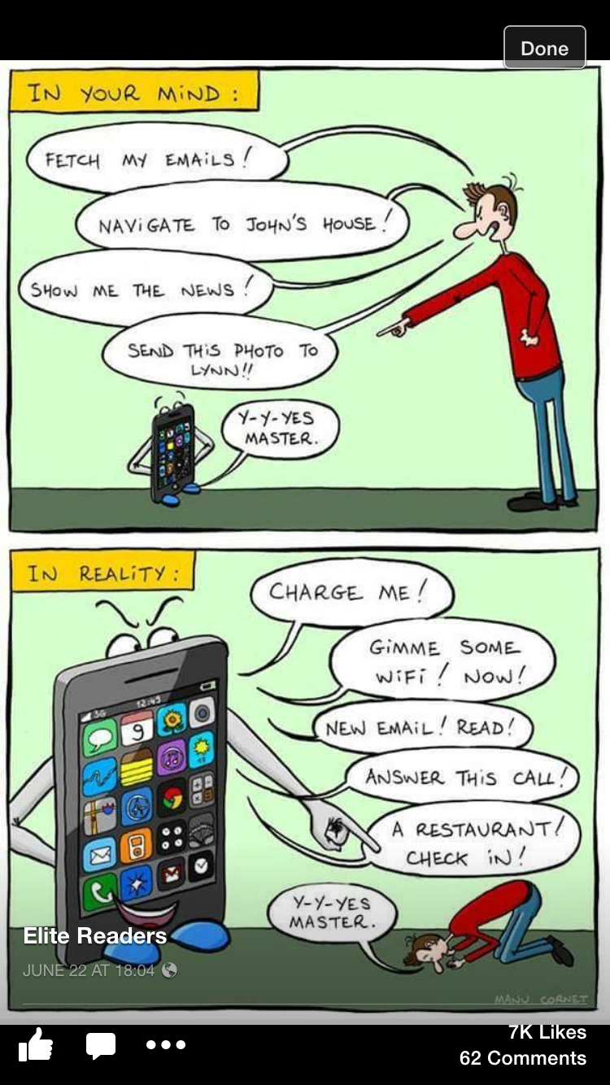
Preview to ‘Phone Story – IV’. My iphone is alive

Slide 6
By 2017, 50% of today's deployed mobile enterprise apps will be completely rewritten or replaced.
By 2018, more than half of all business-to-employee (B2E) mobile apps will be created by enterprise business analysts with codeless tools.
By 2020, lightweight Web- and mobile-style app integration will have completely displaced traditional approaches.
Notes:
Placeholder for text (substitute your own text; delete when not used)

Slide 7
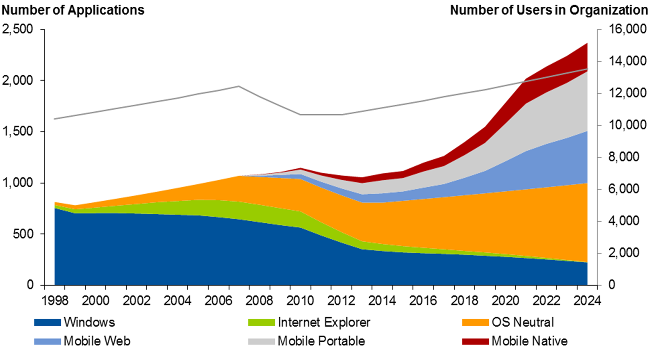
The Enterprise App Explosion
1,400
300
Source: Portable and Web Apps Dominate in Our Mobile Model, Ensuring Maximum Device Flexibility

Slide 8



Enterprise mobility is hard
Michael Facemire
Principal Analyst
Forrester Research

Slide 9
The challenge is daunting
CRM
HR
Directory
CMS
Directory

Slide 10
Start here
API Strategy
CRM
HR
Data Access Strategy
Directory
Superior UX Strategy
CMS
Directory

Slide 11





Mixed
Mixed control
Front end Development Tools
MAF + MAX + ABCS
APIs
APIs
APIs
APIs
APIs
APIs
APIs
APIs
IT Controlled
Mobile Application Integration Platform, typically mBaaS
Location
MCS
Integration
Data Orchestration
Analytics
Data Encryption
IAM
ICS
PCS
MCS
MCS
IDCS
Push Notifications
MCS
Data Synchronization
API Management
API Discovery
Versioning
Collaboration
DOCS + Social
Inside APIs
SOA / OAG
Existing Apps
JCS
Existing On Prem Back-End Systems
SaaS

Slide 12
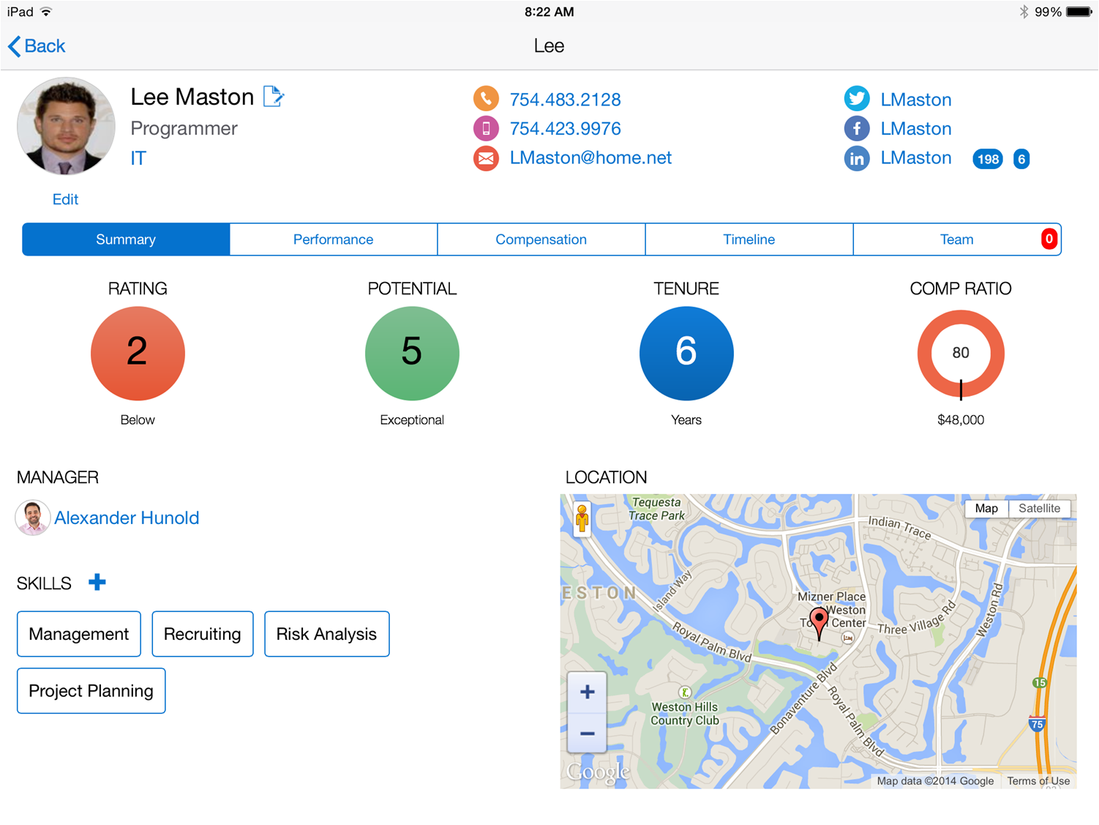
Lets start with a Mobile App. A simple HR Mobile App
Notes:
In order to explain what MCS is, let us first take a look at why we wanted to build MCS from the outside – in.
Imagine that as a mobile developer you were asked to build a mobile app that looked like this – a very simple, elegant HR mobile designed for the HR rep or a manger to use. This screen in this looks relatively simple and has all the data the user needs about their employee.
It has information about the employee, their contact details, their social networking information, their performance information, talent management information, their location etc.
Overall a simple app to build.

Slide 13
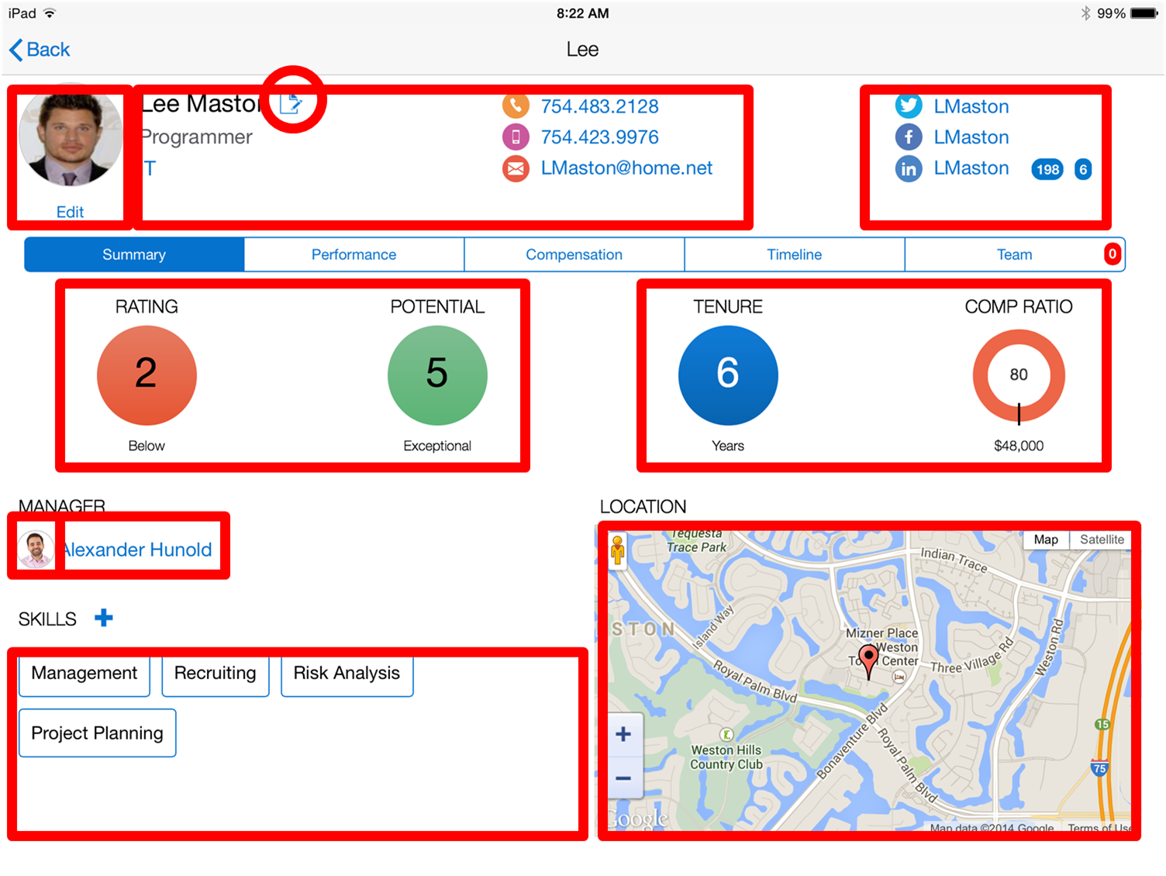
Let’s decompose this app
Notes:
However, when you now start to decompose the app and start highlight the different areas you are mashing up the data for this app, you will realize that (go to the next slide)

Slide 14
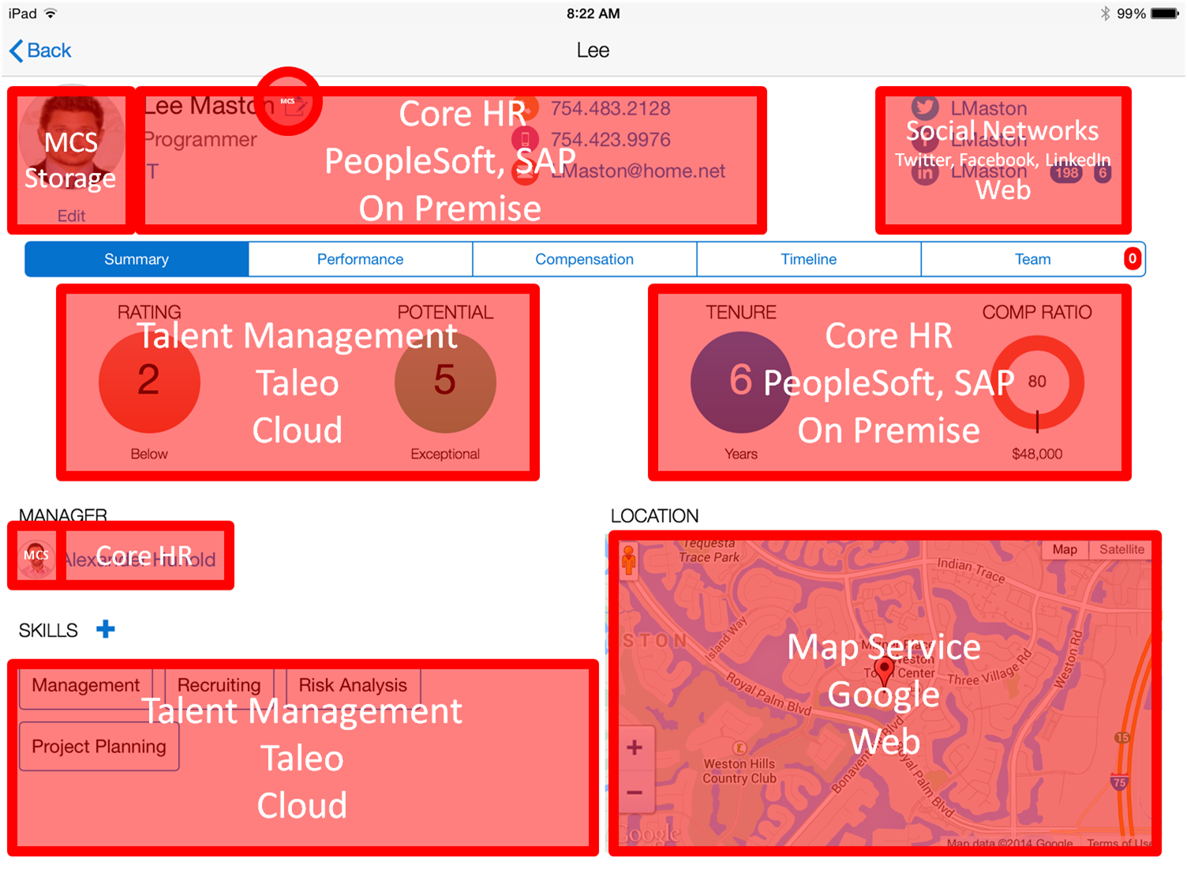
And map it to the systems of record
Notes:
That in fact this simple app is quite complex in that you need to integrate data from multiple systems of record. For e.g. let’s say the HR systems were different based by geo – on premise (SAP in Europe and Oracle PeopleSoft in US), the talent information came from Taelo – a SaaS app Social networking came from LinkedIn, FB and Twitter. Mapping service from Google. This enterprise wants to store employee photo but the backends may not be set up for storing images.
While creating the front end is a relative easy task trying to integrate this data, map user identity and security policies and getting different APIs together is what takes the longest time

Slide 15

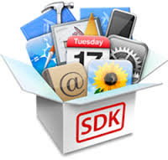




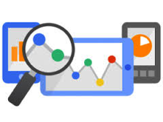


















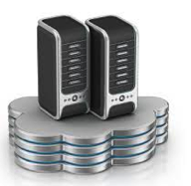
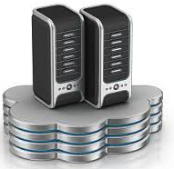

This simple app soon became complicated to develop…
Client Dev Tools
Monitor & Analyze
Mobile Services
Integration
Security
Multiple Environments
Notes:
So now the mobile developer has to figure out
What tool will they use to build the mobile, native or cross platform ?
How do they integrate to these multiple systems of record – 7 in this case
What are the user identity policies for these backend systems. They may be different based on the authentication policy of the backend
IT would need to provide environments for dev, test and prod – multiple environments since the app is not static and will have continuous development
What about adding mobile services like the ability to work in an offline mode, to get push notifications, add geo coding to the employee record
What about diagnostics, analytics to determine how the app is performing, who is using the app etc
In summary, there is a lot that goes on in building a mobile app. Building the UI becomes the easy part. The hard part is managing all these other areas.

Slide 16


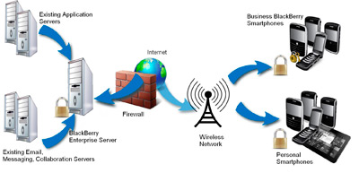

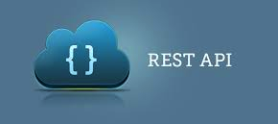


Why Mobile Integration is Different to Traditional Integration?
Connection Availability
Lighter Protocols
Smaller Payloads
Real time higher transaction volumes
Backend APIs not Mobile ready
Wireless Data Plan Cost
Power Savings
End to End Security
Multi Form Factors
Notes:
Why is mobile integration different and hard than traditional enterprise integration. Traditional enterprise integration usually has been about app to app integration or creating a common service bus for web based applications. Mobile applications are different.
They need to deal with poor or no connection. So apps needs to operate in a disconnected mode
Even 4G networks cannot handle all the load. So you need optimized packets in lighter protocols like REST
Mobile apps are purpose built. Backend interfaces may have additional fields that are not required.
Mobile users are unpredictable in their use – you have to architect for an always on, real time flow with high transaction volumes
Legacy backend (on premise) and even the new SaaS application interfaces were not designed for mobile. One issue with the sheer volume of traffic generated with fields that are not needed. The other is with orchestrating 2 or more APIs in one payload to get maximum user experience. Imagine a UI that has data coming from multiple APIs that were dependent on the results of one API e.g. based on “my customers” to get my opportunities, their status and be able to change it. This could result in multiple API calls in the background instead of one
The back and forth of this data impacts wireless data plan cost and device power.
Mobile integration needs to understand complete end to end secuity. There is device security, mobile app credentials, mapping to multiple backend credentials.
And of course the need to build apps to multiple device sizes and in some case headless IoT devices.

Slide 17
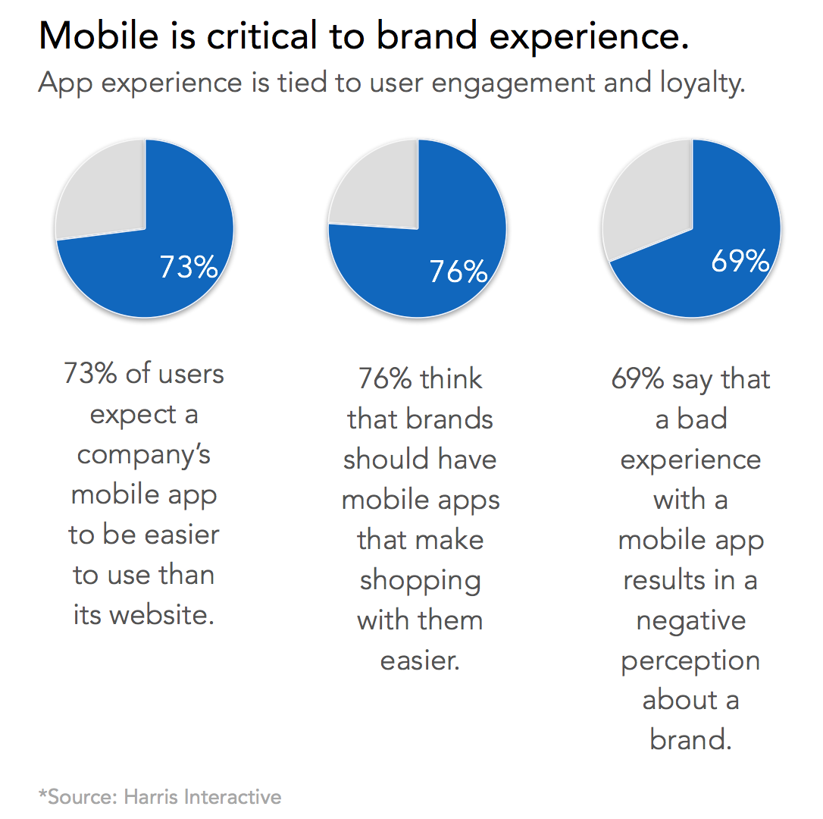
Why Mobile Analytics ?
Mobile Analytics Challenges
CIO: No ROI dashboard with insights into mobile strategy execution
LOB: No insights into application adoption and usage for personalized engagement
Developers: Very complex to measure and derive insights on application crashes and performance
Business Value
Retail Co.: Personalized engagement with users lead to over 20MM downloads = $13B in gross sales via mobile devices
Media Co: Grew digital subscription 50% in 12 months. Segmentation helped with creating profiles to increase reach to 1.3 million people per month
Company with $1B in annual mobile revenue e.g. Starbucks, Domino’s Pizza
97% uptime = $2.5M loss / month
99% uptime = $0.8M loss / month
99.9% uptime = $82K loss / month
Notes:
Many enterprises feel that they have not getting the intended ROI from mobile applications. Many enterprises have jumped into mobile apps with a ready fire and aim strategy without thinking through the business case and ways to drive user adoption. This is true for both B2C apps and B2E apps. B2C apps for most part have app store metrics that provide download numbers or ratings but that is not enough to drive user engagement.
Mobile analytics is a very important area to consider during the mobile development process. This is not quite the same as web analytics where instrumentation is done at the web server end and can be done retroactively. Mobile apps needs to be instrumented during development time to really understand the real extent of application performance and usage. Use one of the stats from the Harris poll to highlight the challenges of not having mobile analytics – you cannot analyze what you cannot measure.
For the CIO :
- The CIO is under pressure to deliver a portfolio of mobile apps by the LOB. However with limited resources, the CIO needs a dashboard on adoption of the apps and the ROI associated with their investment. They have no dashboards that helps them determine which apps should continue to get investment, which apps needs higher user adoption and which apps perhaps do not need any additional investment.
For the LOB:
Very limited insights into usage, retention, identifying who to engage to drive either higher adoption or higher revenue. Ensure for B2C the right campaigns or ads sent at the right time and location.
For the developer / architect
No visibility into app performance, app crashes, what was the overall environment when the app crashed (device, network, other aps etc)
Highlight the impact that Mobile Analytics can bring to the business with the examples on the slide

Slide 18






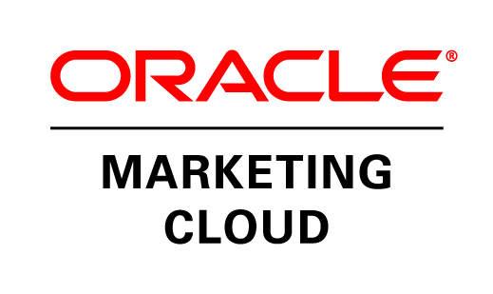


Multi-channel Front Ends
Lots of Back Ends
Internet Services
Normalisation
Blending
Data Shaping
Analytics Mobile Platform
Enterprise Systems On Premise / Cloud
Notes:
Who: Rob
Speaker’s Notes: (Option slide – may not be needed if using previous slides)
Indeed there are lots of mobile front ends – in Oracle’s vision M is not just mobile but Multi-channel – so we embrace wearables, nearables, Nest thermostats and connected cars etc.
And there are lots and lots of backends …. Legacy applications more SaaS and multitude of internet backends including Twilio for messaging webRTC for teal time video.
The focus here is on the mobile app developer – to make it as easy as possible to access these backends and access them and use the data in the mobile app.
The task of the mobile platform is to “Normalise” the access and date from the backends – to make them consistent and easily accessible. This allows information and function from different sources to be blended together to form richer services. The data from the backends can be shaped – transforming it to make more accessible, enriching it with data and making suitable for delivery over an air interface.
And lastly and not least using the data from the apps – context, user behavior, diagnostics to form powerful mobile analytics.

Slide 19









DEVICES AND SERVICES
CLOUD SERVICES
MBaaS
CLOUD SERVICES
Integration Services
Process Services
Security Services
Database Services
Keys to Success
CORPORATE NETWORK AND SYSTEMS OF RECORD
INTEGRATION
PROCESS
DATA

Slide 20
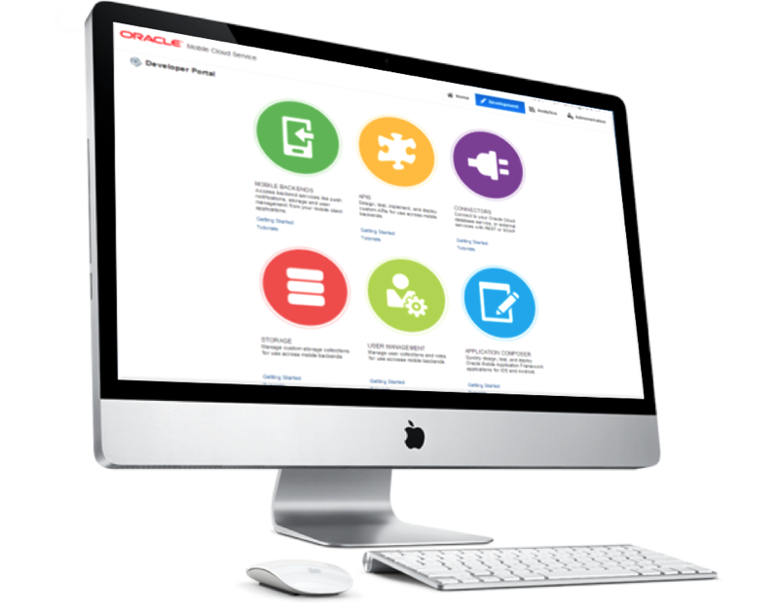
Oracle Mobile Cloud Service (MCS)
Key capabilities
Built for Mobile
Catalog of extensible API
Built in Mobile Services (Offline, Sync, Push, User Mgmt..)
Development environment based on persona / role
Enterprise grade security
Client Development Tool Agnostic
Usage & analytics for developers & business owners
Integrated with Oracle’s complete PaaS solution and applications
Notes:
Who: Rob
Speaker’s Notes:
The Oracle Mobile Service goal is to easily enable mobile application developers that are continually looking for new ways to accelerate development of apps to meet their consumers’ needs. MCS will be a set of cloud-based, server-side mobile services to make app development quicker and easier to deploy. MCS reduces the complexities of the application development by dealing with the complex server side programming, reducing the redundancy in creating backend code blocks, providing ready to integrate features and template backend.
Developers can focus more on the front end of the applications and can have their choice of mobile client development tools including ADF-Mobile for cross platform hybrid apps, native development or other Javascript tools – creating a new meaning for BYOD – Bring your own development
MCS provides a set of rich RESTFul interfaces for all the operations required by the mobile app that abstracts the backend from the mobile developer. In addition it also provides mobile specific interfaces for notification (multi channel – app, SMS), offline data sync, persistence services (to store mobile generated data and user preferences) as cloud data storage service.
From a backend perspective, MCS provides all the tools required by API developers to expose and shape the services to be consumed by the mobile developer. This includes mechanisms to design, create and expose these services in a catalog that can be easily and securely discoverable by mobile developers and integrated into their app.
Security is a critical component and is designed ground up in the MCS. From tokens to developers to develop and consume APIs to encryption policies for data in rest, data in motion, policies for single sign on and federated authentication across multiple data sources via Oauth or SAML and policies for defining access rights to applications via mobile application management or container technologies are services that will be available in MCS
A key component of MCS is to provide developers, IT and business with metrics on service usage and business impact. MCS will be designed to provide technical metrics, engagement metrics, business metrics along with the monitoring and management of the service.

Slide 21
Oracle Mobile Product Strategy
Simplifying mobile development & management PERSONAS
Front End Developer (Mobile)
I build the best mobile user experience
Browse and access mobile API catalog
and SDK
Back End Developer (Service)
I provide access in a secure, scalable, controlled manner
Publish mobile ready services to
API catalog
Mobile Cloud Service (+ Oracle PaaS)
Line of Business Manager/Analyst
I monitor and analyze the success of the mobile apps
Powerful mobile analytics and dashboards for deep insight to the business
Notes:
Who: Rob
Speaker’s Notes: Oracle Mobile Cloud Service delivers real value for key stakeholders within the enterprise.
The Mobile Developer – who is interested in building the best mobile experience in their mobile apps. For them MCS provides access to mobile API catalog and SDK that allows them to easily connect to various system.
The Service Developers -- that typically focus on providing secure access to various enterprise systems can publish their mobile ready service to the API catalog.
The business technologist or manager can leverage the mobile analytics and dashboards to gain insight, monitor and analyze the success or performance of their mobile apps.

Slide 22






Geared for all involved Personas
Line of Business Stakeholders
“I am responsible for the success of our mobilization strategy”
Enterprise Architect
“I make sure we have a secure, scalable solution”
Mobile App Developer
“I create the mobile applications that call backend services”
Service Developers
MCS Admin
MCS Admin
“I administer MCS for our company”
.
Service Developers
“I create the backend services that mobile applications call”
LOB Stakeholder
Enterprise Architect
Mobile Developer
Notes:
Any successful mobile application is a collaboration among multiple groups within the enterprise. Gartner recommends a bimodal approach to unite IT teams and combine agility with stability to address digital opportunities. MCS was designed with a persona based approach with a deep understanding on the roles and needs of these personas and the tools required to make it easy for these personas to deliver on their roles and functions and to collaborate with the other personas. A quick look at the personas, focal with Mobile Cloud Service.
All starts with the LOB Stake holder that has the business requirement – they are responsible for the overall success of the mobile app.
Mobile client developer – responsible for building the client side engaging experiences and consuming services provided from the mobile backend
Service developers – developing or shaping services for mobile client developers to consume
IT Architect – ensuring IT security and architecture compliance
MCS admin – managing the operational maintenance of MCS

Slide 23

Mobile Analytics
@OracleMobile
23

Slide 24




Mobile Proliferation Challenges C-Suite to Rethink Strategy
$3.2
^{Trillion}
By 2017, mobile commerce transactions will reach $3.2 trillion*
Mobile’s Complexities
Close mobile’s analytics gap and plug hole in multi-channel analysis
Move beyond reviews and downloads as Key Performance Indicators
Leverage real-time context for personal engagement and monetization
Reduce development complexity while proving and enhancing app ROI
150
^{Billion}
*Source: Various: Need from Oracle CI Team if used
In the past 5 years, 150 billion apps have been downloaded
Demands Modern Approach
Limited Mobile App
and User Insights
User Experience
Expectations
87
^{Percent}
*Source: Need Source
Companies update or release mobile apps at least every 6 months*
Demonstrable ROI
Not Apparent
Portfolios of Employee and Customer Apps
78
^{Percent}
*Source: Triangle Research Survey, 2014
78% of apps have no mobile analytics to measure and optimize performance*
Rapid Platform
Evolution
Mobile Data Loss
and Breaches
*Mobile Business Statistics, CSO Online 2014

Slide 25
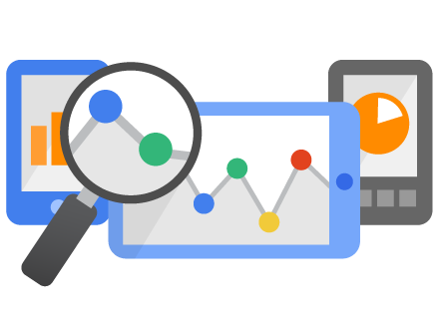
Mobile Analytics
Understand
Collect
Engage
Convert user data into actionable insights
Solve a business need through targeted user engagement

Slide 26











Enable Modern Enterprises to Transform Operations Leveraging Advanced Mobile Technologies
Marketing
Make personalized connections and provide location-based incentives
Retail
Leverage real-time inventory management with location and user-based promotions
Sales
Real-time proposals on mobile devices that accelerate B2B sales cycles
Hospitality
Engage with guests using timely, personalized, and location-based context
Commerce
Create customized offers to reach shoppers anywhere, anytime
Financial Services
Extend relationships with users based on transaction and engagement history
Customer Service
Streamline tasks, staffing, and parts sourcing, improving remote customer service
Media
Deliver content and advertisements to maximize engagement and monetize users
Human Capital Management
Find, recruit, and hire candidates via mobile channels on any device
Logistics
Optimize fleet scheduling and routing to improve driver and dispatcher productivity
* Pending

Slide 27



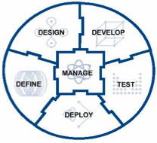



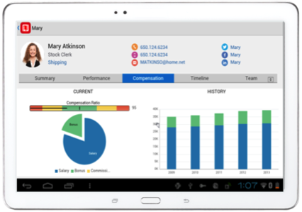
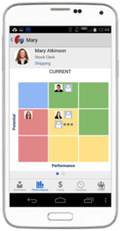





















Oracle Mobile Cloud Service
Outside-in, Mobile First
Analytics
Continuous Development
MOBILE APPLICATION FRAMEWORK
Diagnostics
Usage
Engagement
Monitoring
Inside-out, Service first
SDLC
Built-in APIs
Offline Sync
User Mgmt
Native
Mobile
Cloud Service
ICS
OSB / SOA
Cloud
Notifications
Storage
Connectors
Mobile APIs / SDKs
SECURE
Public Cloud
Oracle Cloud
Enterprise SaaS
On-premise
On-Premise Packaged Applications
3rd Party API
Others
Custom API
Users
Data Shaping
Objs
Custom
Logic
Orchestrate
CUSTOM Applications
Notes:
The Oracle Mobile Service goal is to easily enable mobile application developers that are continually looking for new ways to accelerate development of apps to meet their consumers’ needs. MCS is a set of cloud-based, server-side mobile services to make app development quicker and easier to deploy. MCS reduces the complexities of the application development by dealing with the complex server side programming, reducing the redundancy in creating backend code blocks, providing ready to integrate features and template backend.
Developers can focus more on the front end of the applications and can have their choice of mobile client development tools including ADF-Mobile for cross platform hybrid apps, native development or other Javascript tools – creating a new meaning for BYOD – Bring your own development
MCS provides a set of rich RESTFul interfaces for all the operations required by the mobile app that abstracts the backend from the mobile developer. In addition it also provides mobile specific interfaces for notification (multi channel – app, SMS), offline data sync, persistence services (to store mobile generated data and user preferences) as cloud data storage service.
From a backend perspective, MCS provides all the tools required by API developers to expose and shape the services to be consumed by the mobile developer. This includes mechanisms to design, create and expose these services in a catalog that can be easily and securely discoverable by mobile developers and integrated into their app.
Security is a critical component and is designed ground up in the MCS. From tokens to developers to develop and consume APIs to encryption policies for data in rest, data in motion, policies for single sign on and federated authentication across multiple data sources via Oauth or SAML and policies for defining access rights to applications via mobile application management or container technologies are services that will be available in MCS
A key component of MCS is to provide developers, IT and business with metrics on service usage and business impact. MCS will be designed to provide technical metrics, engagement metrics, business metrics along with the monitoring and management of the service.

Slide 28

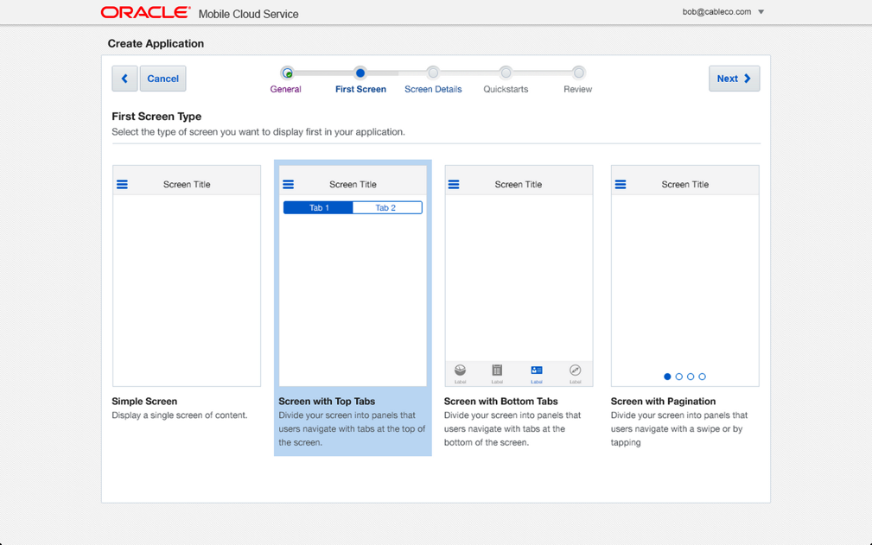
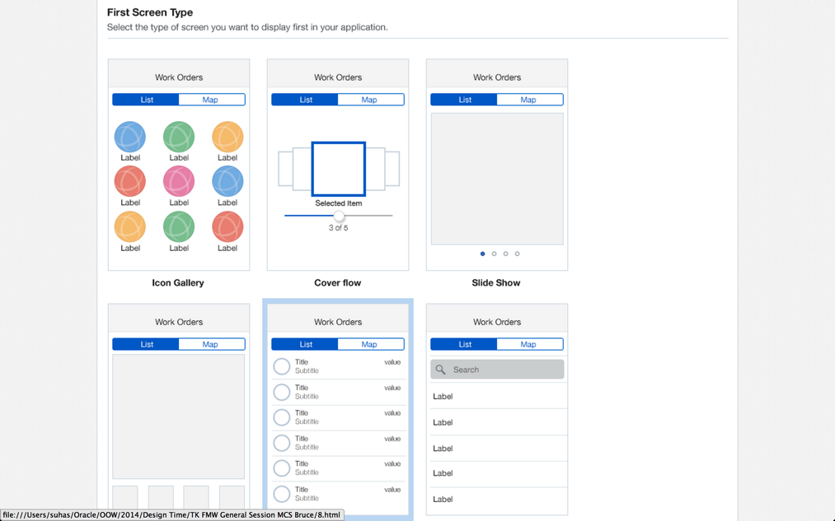
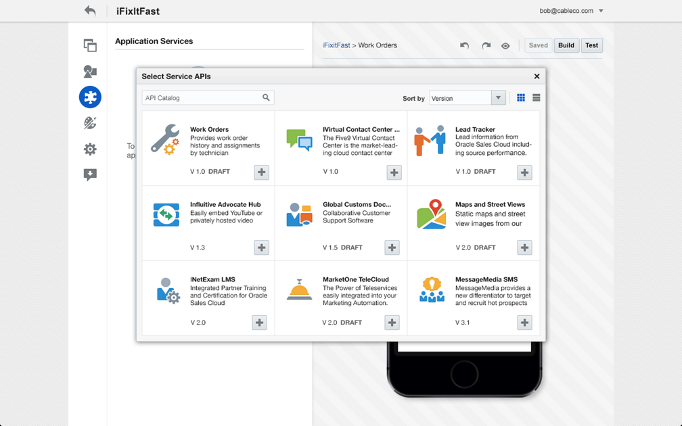
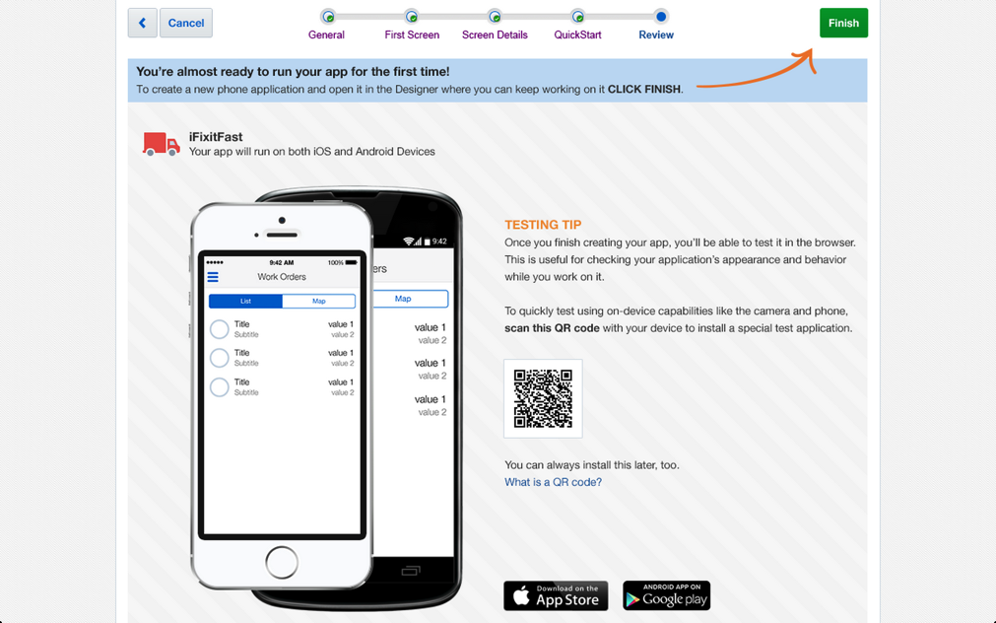
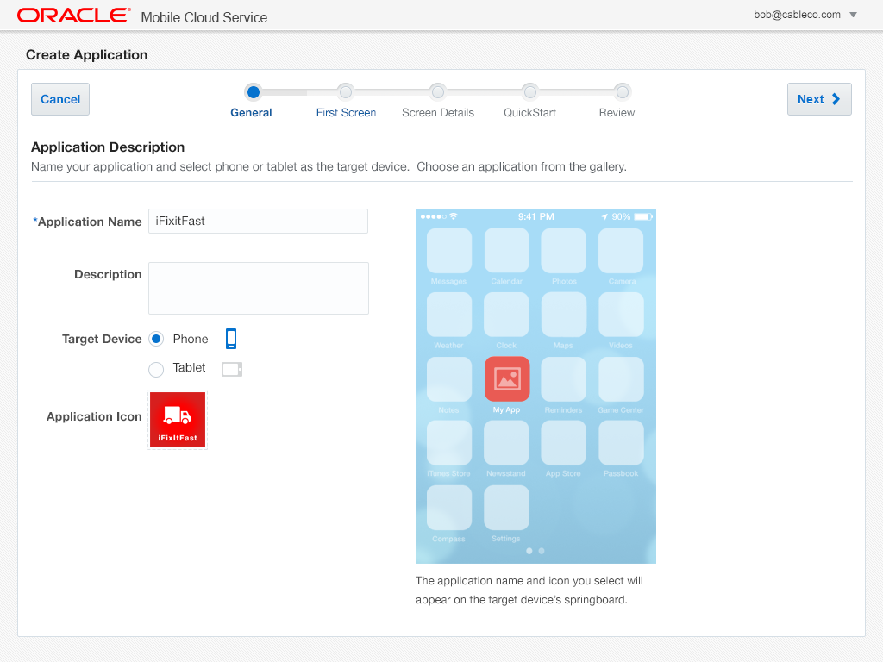
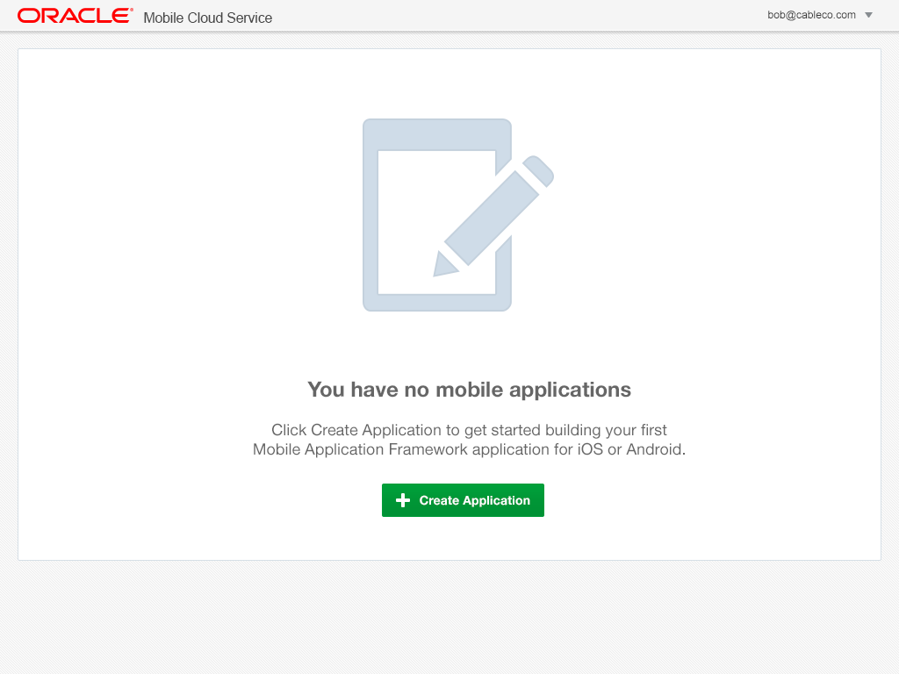
Mobile Application Accelerator (MAX)
Business User Friendly Mobile App Composition in the Cloud
Browser based development
No coding required
Easily map to business services
Preview app in line
Edit, test, and publish from browser
Notes:
Mobile Application Accelerator is a tool targeted at non developers to easily compose mobile applications without writing any line of code
MAX is a browser based tool to easily select screens from a pre set template and connect multiple screens together to create a business flow for a mobile application. This is done with no coding. MAX is integrated with MCS to consume the business services exposed in the MCS catalog. MAX enables the business user to preview the app in the browser without requiring emulators. The business users can perform all the functions of composing the app, editing it, testing and publishing from a browser. Once done they can download the app via a QR code.

Slide 29


Mobile Cloud Service– An Ecosystem Extends and Connects
Systems We Can Connect To
Mobile
Cloud Service
Apps That Can Be Built
Services We Offer

Slide 30
Mobile Cloud Service Demo
30

